Slide 1

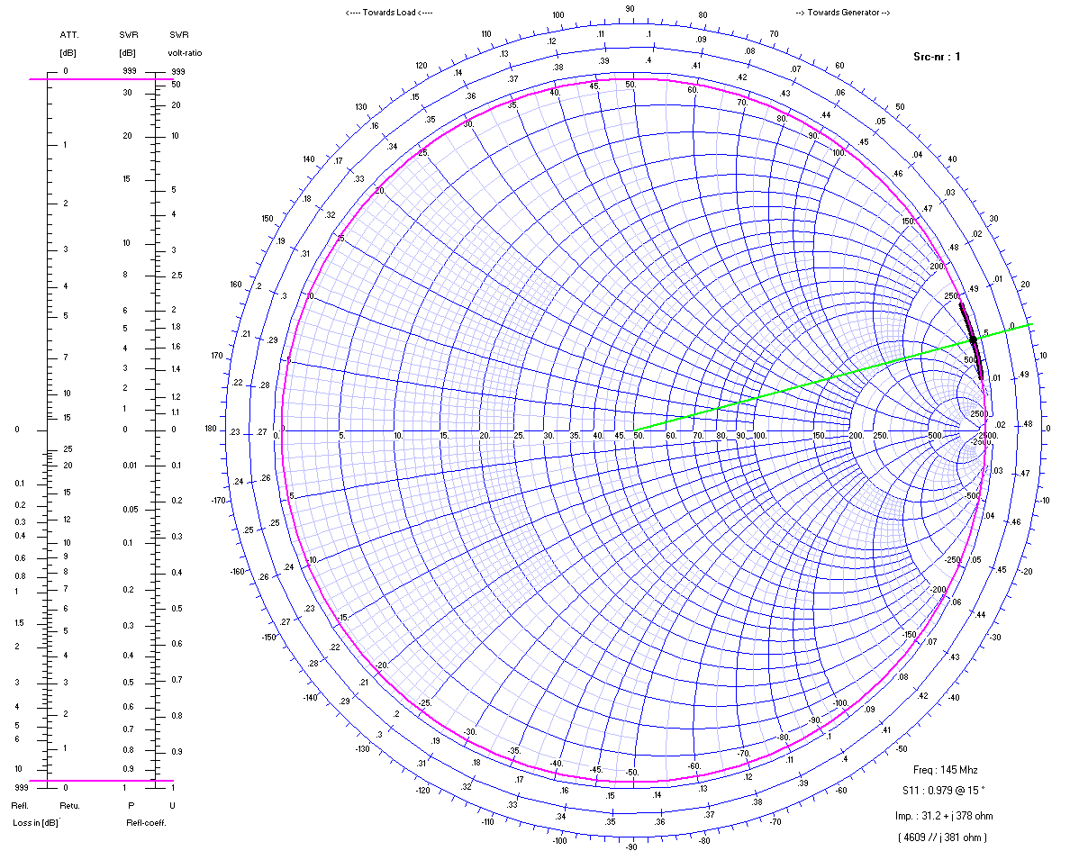
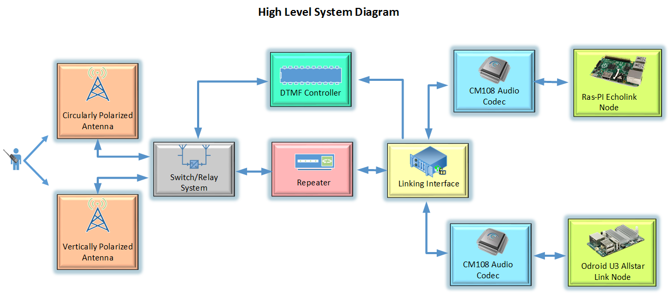
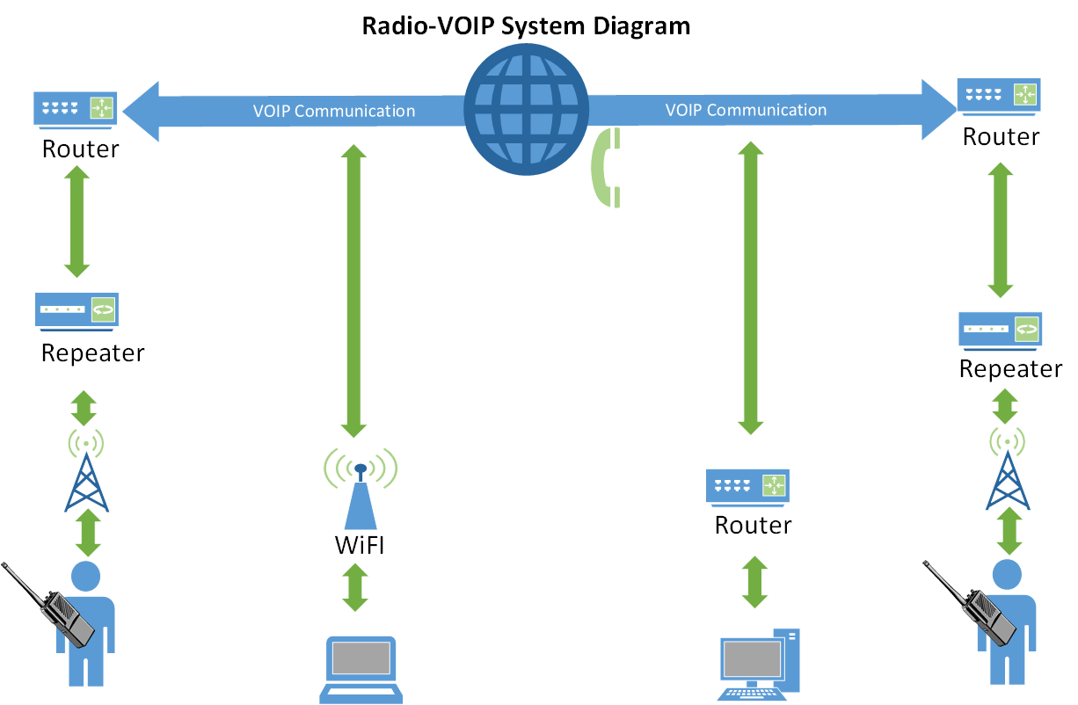
UCSC ARC CPOL Antenna
Kevin Helms, Tim Bodkin, Luis Ceja, Chris Tatosian
Abstract
Overview
Analysis
UC Santa Cruz currently utilizes a repeater which AC6P and K3RRY designed and built for radio communications. The repeater listens for low power signals, beginning with PL tones, at 144.710 MHz and immediately rebroadcasts, or ‘repeats,’ them at much higher power on a 145.310 MHz in order to increase the range of wireless communication. Ideally, for reliable communication a repeater antenna would be at the top of a tall building in the line of sight of those it is trying to communicate with. The location of UCSC and the surrounding geography present a problem with wireless communication and due to the mountainous terrain, some coverage areas are shadowed by hills and are subject to multipath
interference.
We currently have a 7/8 wave vertically polarized antenna on the roof of Baskin Engineering, vertical polarization meaning the electric field vectors of the propagating wave are perpendicular to the
earth. Vertically polarized waves have a high likelihood of being degraded, this is due to refraction and absorption. Different materials absorb and refract waves at different angles depending on how the wave is
polarized. By the time the traveling wave reaches our repeater it may be tilted as it travels over the earth or bounced off objects or hills. By super position this may result in a horizontally polarized wavefront which would cause a loss of 20 dB or more in received power, or multipath interference due to waves being out of phase and cancelling out. Our goal is to create an antenna which radiates with circular polarization. This mitigates the polarization mismatch and results in only 3 dB of loss regardless of how
the linear antennas are oriented and is much lower probability of being degraded due to absorption and refraction compared to linearly polarized waves.
By reducing multipath interference, the circularly polarized antenna design will increase the local reach, and dependability of the UCSC amateur radio repeater. Additionally, two separate RoIP nodes will be implemented which will interface with the repeater, thus providing world wide connectivity with the amateur radio community. RoIP, which stands for “Radio over Internet Protocol” is similar to VoIP, and in fact uses many of the same protocols as services such as skype. By implementing two nodes which use 2 different protocols this would allow the repeater to communicate with people on multiple networks, namely, Echolink, and Allstar Link.
Each RoIP node requires its own linux based single board computer, as well as a path for audio, and control signals, to and from the repeater. Since there will be multiple devices in a single system with a need to meet these requirements, a linking interface has been designed, which directly facilitates the interaction of the audio and control signals to and from the repeater. This linking interface is designed with embedded control logic to ensure that only a single RoIP node can transmit to the repeater at any given time.
Once fully integrated, the system, from a high level perspective will function such that a person in the field will have the ability to communicate with the UCSC repeater through their handheld, mobile, or stationary transceiver. Both the antenna switching circuit, and the
RoIP nodes are designed to be controlled wirelessly via DTMF protocol which is sent from the keypad of the user’s transceiver. Using predetermined DTMF sequences, the user will have the ability to choose which antenna they would like to use, as well as activate, and operate the RoIP nodes, thus giving them the ability to communicate with other nodes, both amateur radio nodes, as well as non-radio nodes.
As shown in Figure 1, the high level description of the signal path shows that all audio will go from the repeater through the linking interface, where it is then sent through audio codecs to the RoIP nodes. The audio is also sent from the linking interface to to the DTMF decoder present in the antenna switching controller. All of these devices are constantly listening for their respective DTMF sequences before they can be activated.
24-30 pt Font only
Approach
Results
Our approach is to design, characterize, and implement a circularly polarized antenna to increase the UCSC AC6P Repeater range and to mitigate multipath interference in troublesome coverage areas. The antenna will be interfaced with the repeater via DTMF protocol, allowing for smooth switching between the current linearly polarized antenna and the circularly polarized antenna wirelessly, from a portable radio. Echolink and All-Star Link nodes will be integrated into the current system with our
DTMF controller, allowing worldwide access to our repeater.
24-30 pt Font only
Conclusion
Acknowledgments
24-30 pt Font only
24-30 pt Font only
Logos of other financial assistance can go here as well (if logo exist)

